Slide 1
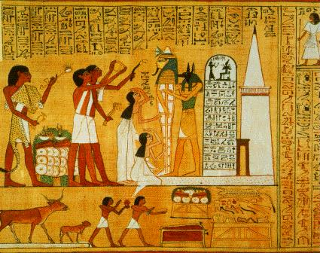
My trip to the British museum
By Louis

Slide 2
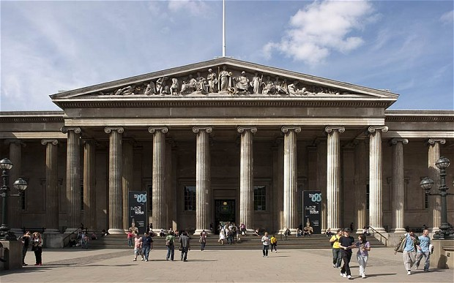
We were expecting to see this beautiful view of the main entrance to the British Museum…

Slide 3
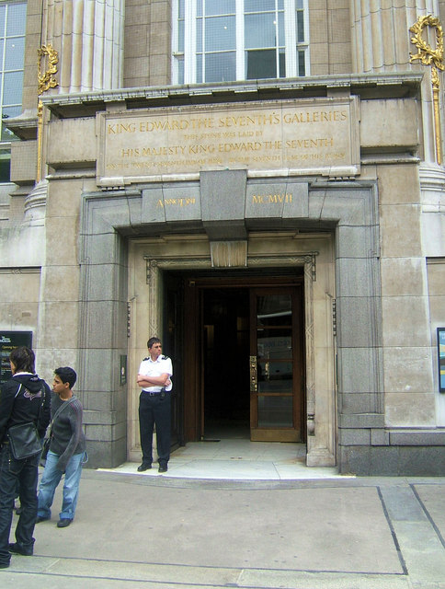
… but instead, we entered through the back door which is less impressive.

Slide 4
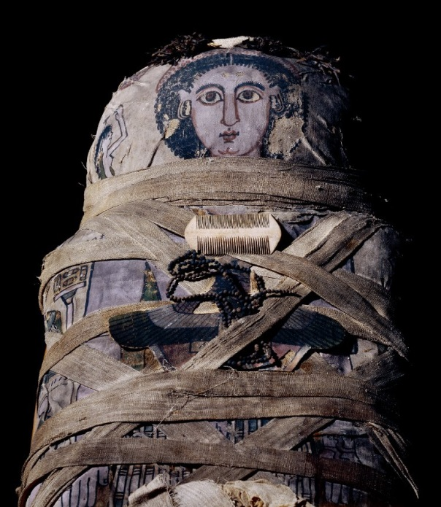
The first thing we did was to listen to a lecture about Ancient Egyptians from a woman who worked at the museum. She told us about everything we were going to see on our visit especially all about mummies.
Cleopatra Mummy
We saw the mummy of a girl called Cleopatra. I felt really weird being next to the mummies because I realised there was a real human being inside and it creeped me out.

Slide 5
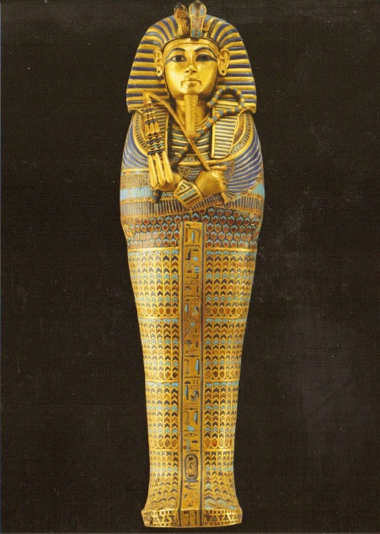
I also learnt all about the mummification process:
Mummification
Firstly you cover the body in salt and leave to dry. Next you remove the organs and pull the brain through the nose. Finally wrap in bandages and place the body in a sarcophagus. Yuck.

Slide 6
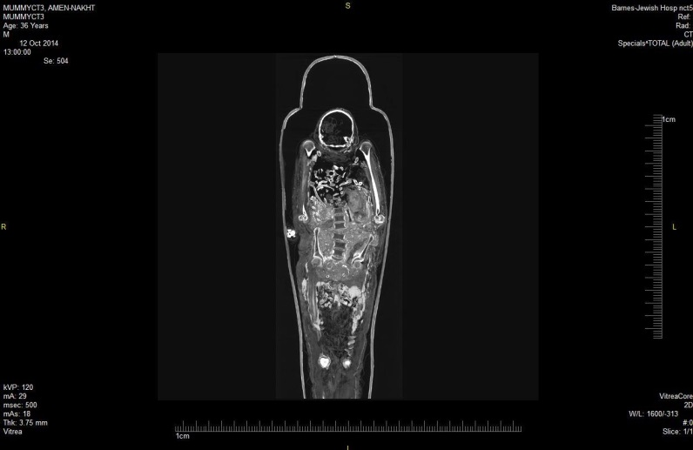
Unwrapping the mummies
Some of the mummies had a CT scan. Now people can see the skeletons of the mummies without having to unwrap them. Also scientists have found a way to unwrap the mummies on the computer using the images from these scans and we were able to see this for ourselves.

Slide 7
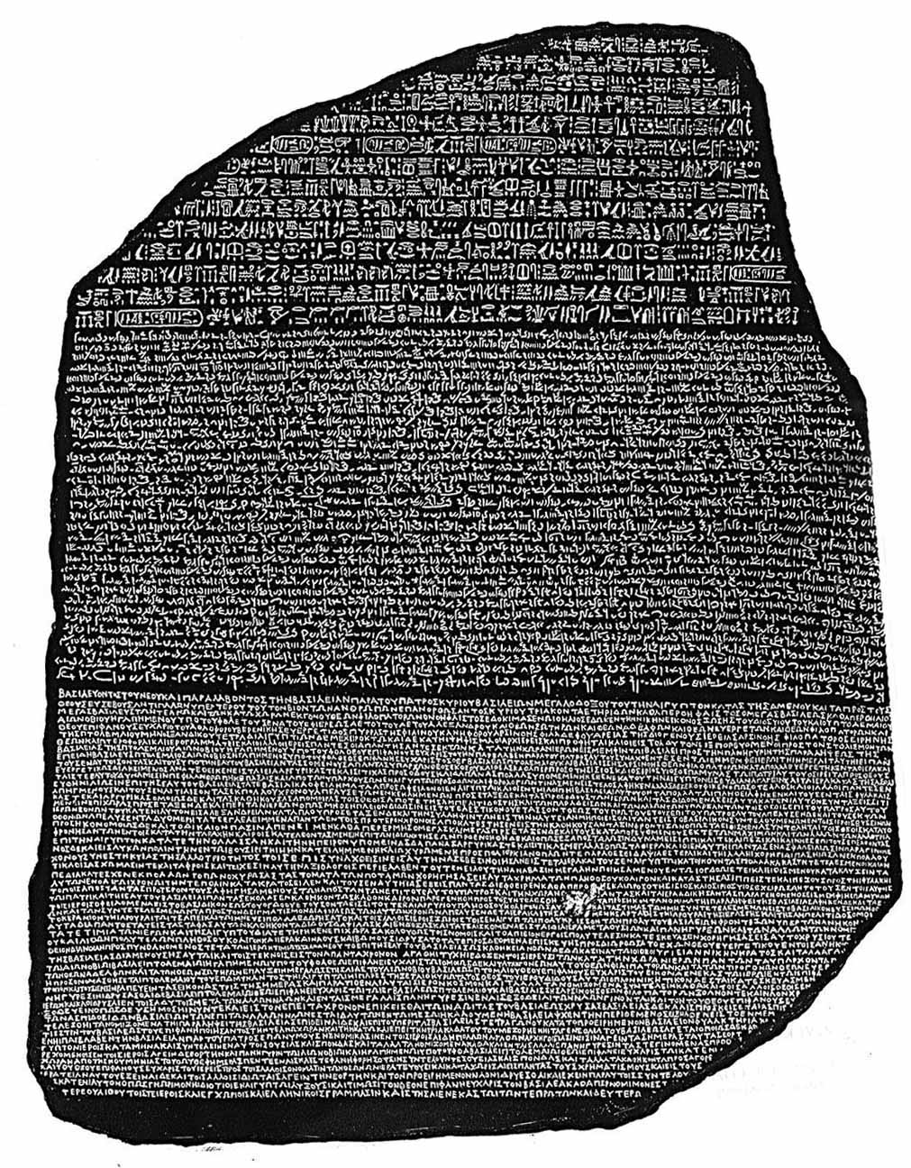
I also saw the Rosetta Stone. This was a dark stone that had writing on it in three languages. One of them is what we now know as hieroglyphics. The other two are ancient Greek and another language called Demotic. The people who found the stone could understand Greek and Demotic so it it became the key to understanding hieroglyphics .
The Rosetta Stone
An ancient Egyptian had just left the Rosetta Stone lying around in the desert. They probably had no idea how important it would become. The Rosetta Stone was the only way for us to understand hieroglyphics - although it was actually talking about taxes (a bit boring!!).

Slide 8
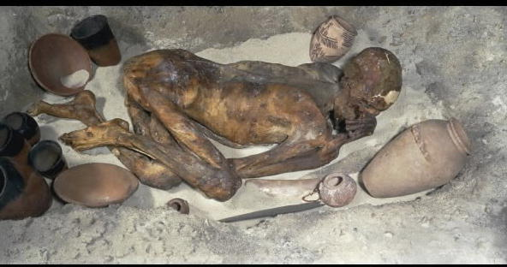
Ginger the Gebelein man
This is a picture of Ginger who was born over 5000 years ago and given to the British Museum 100 years ago. He died in Gebelein in Egypt but his nickname came from his ginger hair. Before mummification was used to preserve dead bodies, they were left in shallow graves in the sand which helped to keep them fresh for a long time. This is how Ginger survived. If jackals had found his body they would have eaten it and Egyptians believed that if your body was eaten you wouldn’t go to the afterlife.

