Slide 1
TUDOR SPORTS
By Ishaan Gandhi

Slide 2
Tudor Sports
Football
Bear Baiting
Jousting
Tennis

Slide 3
Tudor Football
This was popular even back in Tudor times.
The number of players was not limited in each team. Sometimes one entire village or town would play against another.
The goal posts were not found at either end of pitch. In Tudor times the goals might be a mile apart!
The ball could be kicked, but it could also be carried and thrown.
A similar football game is played every year on Shrove Tuesday at Ashbourne, Derbyshire.

Slide 4
Bear Baiting
Popular with poor and rich people.
Bear baiting was considered a cruel sport and was banned in 1585.
The sport involved a bear being chained to a wooden post in the centre of a ring.
A group of dogs would then be released attacking the bear and trying to kill it by biting its throat.
Both Henry VIII and Elizabeth I enjoyed watching this sport.

Slide 5
Jousting
Jousting was the most prestigious sport in Tudor England. Only the upper classes were allowed to take part in jousting.
It was even common for a young King Henry VIII to take part in larger competitions.
Jousting involved two armoured knights separated by a four foot high wooden barrier. Each knight carried a lance and the objective was to knock your opponent of their horse.

Slide 6
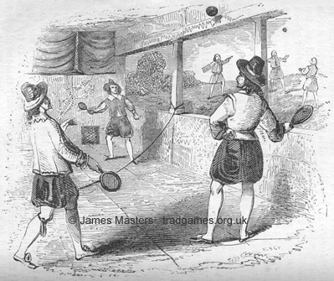
Tudor Tennis
Tennis is one the oldest of all racquet sports.
During the Tudor times it was played indoors in a large room with a net. Like we play tennis today, players had to hit the ball over the net.
Henry VIII enjoyed the sport so much he had a court built for himself at Hampton Court in 1530 and he would spend huge amounts of times within its four walls.

Slide 7
THE END

